Slide 1

The future for HR & resourcing
Andrew Lambert
Copenhagen 22 June 2017

Slide 2
Agenda
HR’s challenge
2 Beyond ‘HR’
Resourcing - into the future
4 What next

Slide 3
HR’s evolution
What next?
‘Strategic’
HRM,
human
capital mgt
Organisational impact
HR
management
From
Welfare
Officer to Labour
Manager
Personnel dept &
Training
dept
Pre-1945
1945-80s
1990-2000s
2000s
2018-??

Slide 4
Drivers of change
‘People’ are central to strategic and operational challenges
VUCA
environment
Technology & analytics
HR’s purpose, staffing and
structure
Cost-effectiveness & innovation
Workforce &
nature of work
What answers does HR have for organisation-critical issues?

Slide 5

VUCA world for leaders (& HR)
Globalisation – economic and labour markets, 24 hour pressures
Geo-political instabilities and conflicts; ‘world order’ challenged
Societal change – decline in deference, demand for transparency
Technology acceleration – leaders, strategies, regulators etc struggle
Poor leadership and governance exposed easier and quicker
Operating in the digital world demands new skills, strategic focus,
organisation models and leadership philosophies

Slide 6

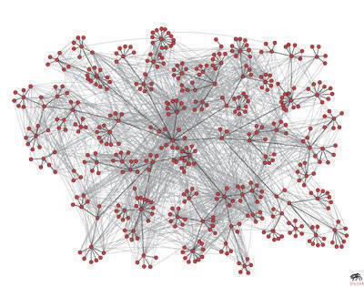


People technology/analytics
Mobile
Integrated & shared platforms
Social and consumerised
AI and automation
Cyber security – attitude & systems
Analytics revolution
Managing information overload
Insight not numbers - intelligence
Big and ‘little’ data
Self-service – game-changer for HR

Slide 7


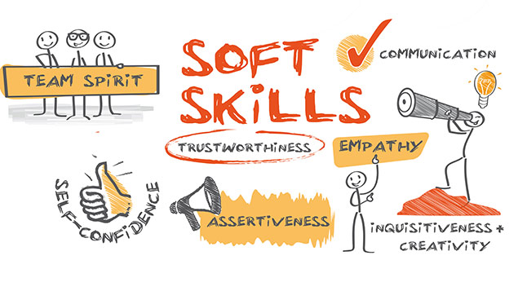
Workforce
Managing multiple generations…
…but Millennials will take over!
Diversity
Changing nature of work
Projects, fluid structures
Digital capability, numeracy…and
Soft skills: collaboration, learning
Skills redundancy – need adaptable self-transformers
‘Gig economy’

Slide 8



Cost-effectiveness & innovation
New business models
Re-purposing – why use us, work for us?
Do more with less – ‘lean’, ‘agile’
Shrink back-offices (’bureaucracy’)
Justify (and find) funding
Continuous change is the norm
Innovate, re-invent… or die
Often applies to public sector &
NGOs as much as to commerce

Slide 9

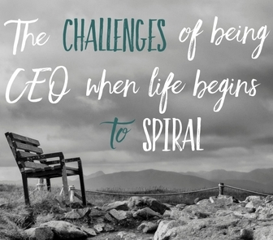
Leaders need help
Re-shape their organisations
Manage their key people
Sustain the ‘brand’
Prepare for and handle their own pressures and needs
Where is my critical support?
HR leader? Finance? IT/CIO?
‘chief transformation officer’?
Consultancies?
Personal coach?

Slide 10


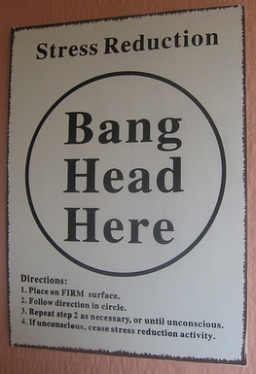
Managers need help
Leaders at their level
- Supported, empowered? Role-models?
Managers responsible for people (not HR)
…. but too often….
  HR self-occupied
  Tensions about who does what
Over-promoting task mgrs, technicians, bullies and ‘politicians’
Selected/trained as people developers?
Struggling with rigid processes (eg performance and reward)

Slide 11
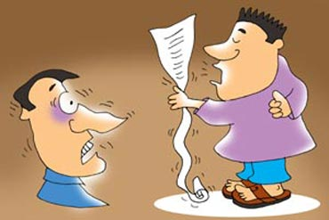


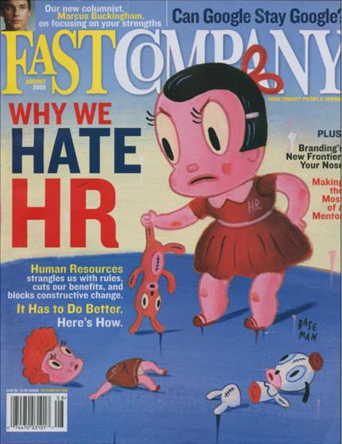
HR under growing pressure
25 years of negative reports about HR
Main criticisms
Poor ‘business’/strategic understanding
Numbers-shy, weak ‘business cases’
Prone to jargon, fashions, not evidence
Focus on individuals, not organisation
Rule and process-fixated (not outcomes)
Technologically challenged
Lack courage to challenge bad behaviour
Not a function for high achievers
Can HR really transform itself?

Slide 12

Winds of change
Talent/skills shortages increasingly recognised as a critical risk factor
Growing intolerance of poor leader and manager behaviour (eg Uber)
‘Glassdoor’ – verdicts on employers/leaders
Wider adoption of integrated and cloud-based, self-service systems
Impact of social media (for better or worse)
New approaches to performance/reward
Business and HR analytics

Slide 13

Death-knell for ‘old’ HR
Technology creating a ‘tipping point’
Self-service – a game-changer
  - replaces HR-generated reports
  - makes HR admin redundant
BPs need to ‘up their game’
    basic advice automated or outsourced
    short-term – help mgrs get best out
    of systems, but after that??
  Specialists – real ‘experts’ or HR managers on job rotation?
All 3 ‘legs’ of HR under pressure to demonstrate value add

Slide 14


Address HR purpose and role
What is HR for?
Change expert and facilitator?
Organisational strategy shaper?
- Answering critical strategic questions
- HR strategy built in, not ‘follow-on’
Performance & capability enabler/coach (at every level)?
OR
Order taker and implementer?
Process manager?
Prop for poor managers?
Increasingly replaceable by technology

Slide 15

Beyond ‘HR’
The next stage in getting the best out of people

Slide 16


High-performance people ‘philosophy’
Replace ‘control’ with enablement
- foster ideas, maximise talent
- co-creation and involvement
Trust - valued colleagues, not just employees
Customer relationship and crowd resourcing methods/systems
Foster collaboration and networking
- break down silos, reward problem-solving & team performance, transparency
Requires unwinding deep-seated power and status beliefs/practices/structures

Slide 17

Organisation Services, Analytics
Integrated service function - finance, HR, IT etc
- built around internal customer needs, not historical functional silos
- better value, service, convenience, at lower cost
- mission: help employees be as productive as possible
- customer focus, continuous improvement, smart-tech
- insourced or outsourced or a blend – quality counts
Integrated business analytics function
- clear line of sight, front to centre, across functions
- NOT about central control – about sharing, learning

Slide 18

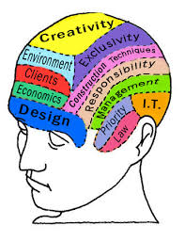

Organisational effectiveness
Multi-disciplinary function - expert in change, performance and development
Architect - strategy, analysis, design, policies
Coach - building up calibre of leadership, talent and skills at all levels
Organisation/business and people experts
Reduce need for external consultancy – but blend internal and external expertise flexibly
Leaders/managers have you on speed-dial

Slide 19

Transitioning from HR to OE
Higher level of expertise in classic HR areas, and more
- Integrated thinking/practice across all areas
- All underpinned by Employer Brand, OD & relationship mgt
- Purchasing and supplier management skills
Combined with understanding of strategy, finance, law, marketing, Ops Mgt, IT etc
Structure – 3 ‘legs’ become two – OE & Services
OE – driver of ‘head office’ design, teamwork and service
- and close involvement with strategic planning

Slide 20

This will take time
Threatens traditional HR mentality, roles, ‘power’
Other functions may be nervous too
Managers wary of more work, poor IT
Addressing years of under-investment in people managers and leadership
Distinct shortage of OE capability
However…
The technology already exists
Organisational leaders will demand greater effectiveness & productivity, less cost
Some organisations already edging this way
Gap between high and low performing organisations may widen

Slide 21


Tackling the capability gap
Recruit HIPO managers from the ‘line’
Retain/develop the best HRBPs, specialists
Attract young talent able to be change agents
Incorporate external experts
Transform HR curriculum into rigorous OE development path (inc. specialised MBA)
Larger organisations can use Mgt academies; ‘professional bodies’ (eg CIPD, ACCA, CIMA) to re-shape who they are and what they do
Do HR leaders have what it takes to transform themselves, their organisation and their function?

Slide 22

Resourcing/recruitment
Into the future

Slide 23


Talent and skills needs
Talent/skills - key driver of organisational success and resilience; core risk factor
More of these….
- Soft skills and emotional intelligence
- Diversity, ability to operate globally
- Data science and tech savvy
- Learning and collaboration orientation
Cultural fit
Adaptability and ability to re-skill

Slide 24
Other trends
Smart automation of selection, assessment and recruitment, supported by AI
Employee-friendly policies – fit to individual needs
Relationship management – tech enabled
- Lifecycle from first contact to alumni
- Boomerang workers
- Contingent workers (blended workforce)
- Employer brand management is critical
Onboarding integrated into onward development
More rigour, eliminate sloppy/disconnected practices

Slide 25
What next?
Thinking points and discussion

Slide 26

What about you?
What are your organisation’s critical challenges?
Are you part of the solution?
Are you the performance and capability expert?
Have you facilitated a purpose, culture and
systems platform so people give of their best?
Are you ready to re-shape HR for the future, tailored to your organisational challenges?
Are you addressing your own capability needs in order to add real value, ongoing?

Slide 27
Reading (quick & easy!)
Future of HR
http://www.hrmagazine.co.uk/article-details/a-blueprint-for-hr-now-and-in-the-future
http://www.hrmagazine.co.uk/article-details/a-new-hr-blueprint-from-hr-admin-to-employee-services
http://www.hrmagazine.co.uk/article-details/a-new-hr-blueprint-organisational-effectiveness
http://www.hrmagazine.co.uk/article-details/a-new-hr-blueprint-capabilities-and-careers
https://creelmanlambert.wordpress.com/boards-and-hr-how-oversight-of-human-capital-works/
https://creelmanlambert.files.wordpress.com/2011/10/a-board-capable-hr-leader-what-to-look-for.pdf
http://www.hrmagazine.co.uk/article-details/the-future-of-work-hr-capability-diversity-and-technology-key-concerns
http://www.hrmagazine.co.uk/article-details/have-data-and-technology-really-made-hr-smarter/335240/
http://www.hrmagazine.co.uk/article-details/improving-the-hr-talent-pool
http://www2.cipd.co.uk/pm/peoplemanagement/b/weblog/archive/2015/03/24/the-future-of-hr-is-about-relationships.aspx#
http://www.hrmagazine.co.uk/article-details/will-ai-augment-or-replace-hr/350381/
People leadership
https://www.forbes.com/sites/brentgleeson/2017/03/27/the-future-of-leadership-and-management-in-the-21st-century-organization/#6f63365c218f
https://www.forbes.com/sites/jacobmorgan/2016/03/28/what-does-leadership-look-like-in-the-future-of-work/#53b7fb222704
https://outlook.office.com/owa/?viewmodel=ReadMessageItem&ItemID=AAMkAGMwYjE0YzZkLTljYjItNDNkZC1hYmNhLThlYTM0OTBjNWY1MQBGAAAAAADH2U0ZxiFeSIyLy1K9cMCzBwAGQg7ml3UNQYlMqvMXuKmrAAAAAAEMAAAGQg7ml3UNQYlMqvMXuKmrAAAw7%2bwfAAA%3d&wid=97&ispopout=1&path=
https://www.cipd.co.uk/knowledge/strategy/leadership/purposeful-leadership-report?utm_medium=email&utm_source=cipd&utm_campaign=cipdupdate&utm_term=319002&utm_content=140617-10363-42761-20170615104807-stimulating%2C%20new%20study
http://www.ccl.org/wp-content/uploads/2015/04/futureTrends.pdf

Slide 28
4 key take-aways
AI will transform core organisational functions. Are you prepared for this?
Will you/HR be a shaper or be ‘shaped’? What do you need to do to be a ‘shaper’?
Capability (inc leadership, talent, skills) is critical to sustainable performance. Are you essential for that?
‘Intelligence’ drives decisions. Have you equipped your organisation with the analytics firepower to ensure they are sound decisions?

